Slide 1
Value Proposition & Differentiators

Slide 2
The reality is that
THE DIRTY SECRET
Enterprise Information Management Platforms and Data Warehouses have repeatedly failed to deliver on their promise.
85%
of Big Data Projects FAIL…
WHAT WE UNCOVERED...
Too much data (multi- location, shape & speed)
High error rates (Poor data quality)
Long project implementation cycles can’t match speed of change
Massive cost blowouts
There is a never-ending search for the bigger, faster, next-generation Centralized Data Platform

Slide 3
We believe that
Every organization has data everywhere in today’s world
5 integration styles:
ETL- ELT
Replication
Messaging
Streaming
Virtualization
Zetaris won’t make you pick an integration style. Our advice is to choose the style or styles that makes sense for your business and your data. We give you architectural optionality to select the appropriate style for each workload or use case.

Slide 4
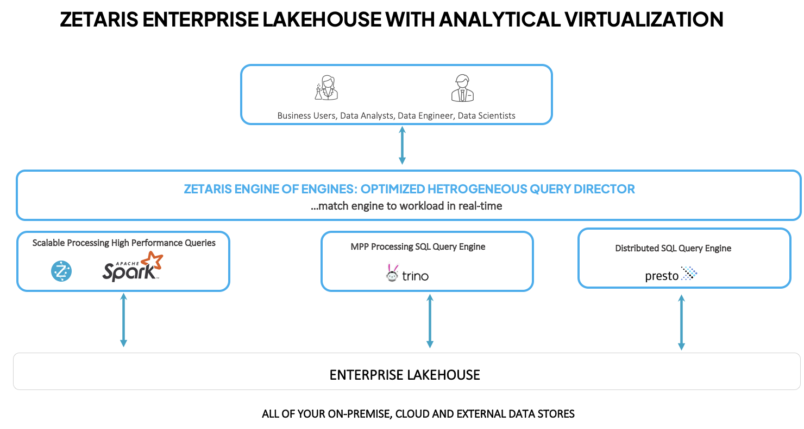
Zetaris Engine of Engines Matching the engine to the workload in real-time

Slide 5
Differentiators The Networked Data Platform
Differentiators
Fastest Distributed SQL Engine
Query optimization to manage compute, performance, and cost Intelligent indexing and caching
Federated Computational Governance
Enterprise-grade security, fine-grained access control, encryption and masking Active metadata management for continuous classification of sensitive data
CLOUD NATIVE ARCHITECTURE
Easy Connectivity
Frictionless cross-platform real-time data integration and access layer Self-service no-code and low-code integration using a familiar SQL interface
Engine of Engines
Get the lowest total cost of ownership by matching the right workload to the right engine
User Experience - No Code
Web-native interface with fully tested and stable releases around the clock 24/7 customer support

Slide 6
Decentralization of data requires new thinking and skilled professional services
PARTNER SALES BENEFITS
Business Requirements & Data Discovery
Business Engagement & Use-Case Prototyping
Enables partner to sell more services of a higher order
Accelerates the number of projects delivered by 3X
Accelerates partners sales process with ‘Zetaris Express’ delivering outcomes in 4 weeks
Empowers partners customers with more agile and intuitive capabilities by powering innovation and delivering solutions at scale
Enables partner to be more responsive to client's time to market needs
Enables deeper and more accurate insight
Strategy, Advisory, Roadmap
Architecture & Design
Project Planning, Governance, Agile Execution, PMO
Install, Configure, Build, Integrate
Data Security Architecture & Model
Virtual Data Architecture
(Industry models, Data Vault)
Real-Time Data Quality Framework
Implement Policy-based Security & Governance Model
Data Integration Services
Data Visualization & Reporting
Technical Support
Training, Coaching
Managed Services
Data Science AI/ML Services
Advanced Analytics
ZETARIS © 2022

Slide 7
AWARDS
2017
2018
2019
2020
2020

